Slide 1



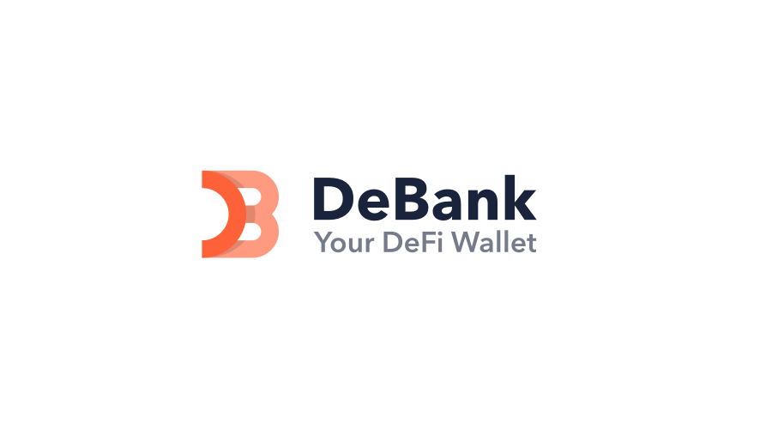
UX AUDIT REPORT
JANUARY 2024
High level expert review
Heuristic evaluation & user interviews

Slide 2
1. INTRODUCTION - What we did
Executive Summary
Goals and objectives
2. METHODOLOGY- Process and Methods
Nielsen's Heuristic Evaluation
Ben Shneiderman’s 'Eight Golden Rules of Interface Design
Arnold Lund's 34 Usability Maxims
Norman's Theory of Action
Web3 Design Audit Checklist Based on Web3 Design Principles by Beltran
3. FINDINGS - What we tested on
Recommendations
4. INSIGHTS AND NEXT STEPS - What we tested on
Recommendations
In this report

Slide 3

DeBank
UX AUDIT REPORT
INTRODUCTION

Slide 4
EXECUTIVE SUMMARY
In this comprehensive UX audit, we conducted an expert review of DeBanks user experience based on Web3 usability guidelines and expert review checkpoints. The aim was to assess the platform's alignment with industry best practices, ensuring a seamless and user-centric experience for all users interacting with Web3 technologies.
Our review focused on evaluating critical aspects such as platform accessibility, navigation, search functionality, user education, error handling, and the integration of Web3 wallet functionalities. Through a meticulous assessment, we identified several areas that require immediate attention to enhance the overall user experience.

Slide 5
247 WEB USABILITY GUIDELINES
This review focused on evaluating critical aspects such as platform accessibility, navigation, search functionality, user education, error handling, etc. Through a meticulous assessment, we identified several areas that require immediate attention to enhance the overall user experience.
UX PRINCIPLES | COMPLIES | DOESN’T COMPLY | NOT APPLICABLE | COMPLIANCE RATE
Home Page | 11 Criteria | 1 Criteria | 1 Criteria | 91%
Task orientation | 14 Criteria | 8 Criteria | 2 Criteria | 63%
Navigation and IA | 12 Criteria | 7 Criteria | None | 63%
Forms and data entry: | None | None | 16 Criteria | None
Trust and credibility | 7 Criteria | 1 Criteria | None | 87%

Slide 6
UX PRINCIPLES | COMPLIES | DOESN’T COMPLY | NOT APPLICABLE | COMPLIANCE RATE
Writing and content quality | 18 Criteria | 1 Criteria | None | 94%
Page layout and visual design: | 26 Criteria | 6 Criteria | 2 Criteria | 81%
Search usability | 11 Criteria | 5 Criteria | None | 68%
Help, feedback and error tolerance | 20 Criteria | 3 Criteria | 2 Criteria | 86%
Total | 119 Criteria | 32 Criteria | 23 Criteria | 79%

Slide 7
REVIEW BASED ON WEB3 UX PRINCIPLES
By Beltran
This review focused on evaluating critical aspects involved in the integration of Web3 wallet functionalities.
UX PRINCIPLES | COMPLIES | DOESN’T COMPLY | NOT APPLICABLE | COMPLIANCE RATE
Transparency of Data provenance | 2 Criteria | 2 Criteria | None | 50%
Transparency of Transactions | 8 Criteria | None | None | 100%
Transparency of Smart Contract | 1 Criteria | 1 Criteria | 1 Criteria | 50%
Transparent User interaction History | 1 Criteria | 2 Criteria | None | 33%
Transparency of Code | 3 Criteria | 4 Criteria | None | 42%

Slide 8
UX PRINCIPLES | COMPLIES | DOESN’T COMPLY | NOT APPLICABLE | COMPLIANCE RATE
Human Readable Hashes Format | 4 Criteria | None | None | 100%
Time/Wait Management | 2 Criteria | None | None | 100%
Permanent Newbie Mode | None | 3 Criteria | None | 0%
Gas Price and Transaction Reversal | None | 2 Criteria | 1 Criteria | 0%
Sense of Community | 4 Criteria | None | None | 100%
Total | 25 Criteria | 14 Criteria | 2 Criteria | 64%

Slide 9
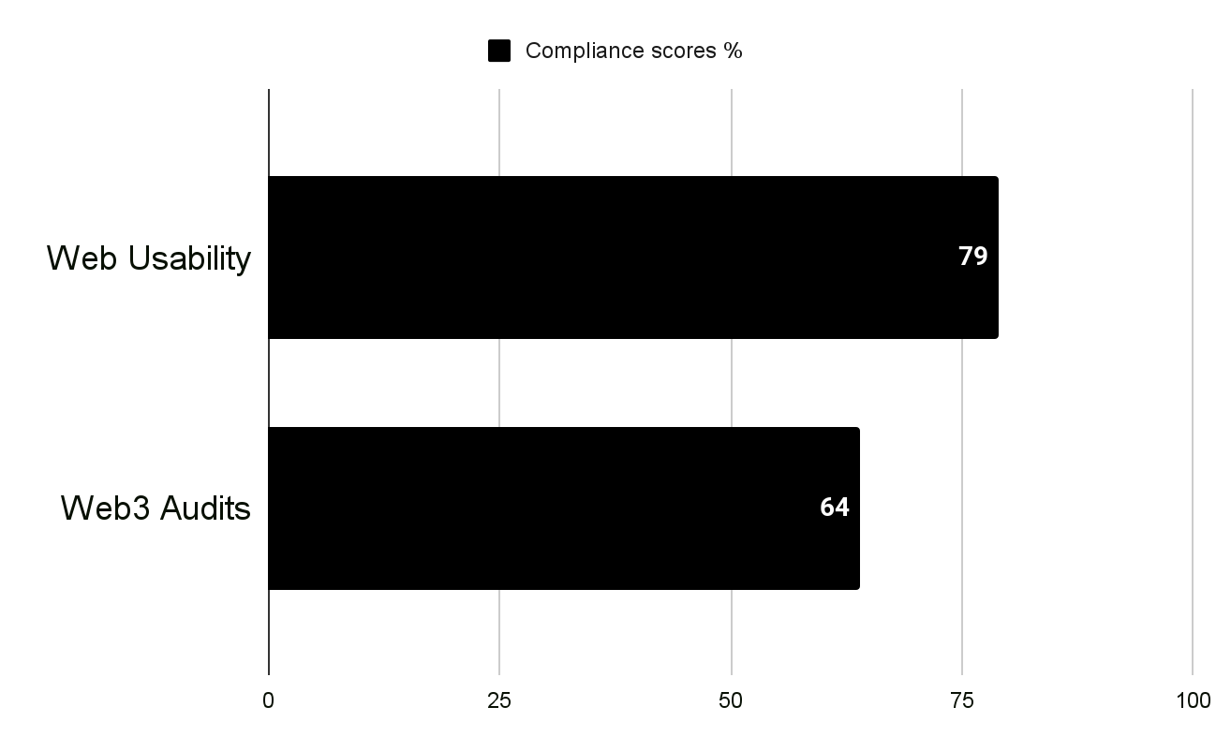
USABILITY STATS
Overall Compliance percentage
Usability Score
GOOD
75.7%
Users should be able to use this site or system with relative ease and should be able to complete the vast majority of important tasks.
Overall Compliance
Overall non compliance
144/190
46/190

Slide 10
PRODUCT OVERVIEW
DeBank is a decentralized finance (DeFi) analytics platform. It provides users with insights and information about various DeFi protocols and their performance on different blockchain networks. DeBank allows users to track their DeFi portfolio, view real-time data on token prices, liquidity pools, and other relevant metrics within the decentralized finance space.
CONTEXT OF THE AUDIT
This study involved collecting a rich research database consisting of detailed observations and findings based on Nielsen's Heuristic Evaluation,
Design Arnold Lund's 34 Usability Maxims, and Web3 Design Audit Checklist Based on Web3 Design Principles by Beltran
These valuable resources complement and support the findings presented in this report.

Slide 11
DeBank
UX AUDIT REPORT
METHODOLOGY

Slide 12
METHODOLOGY
This report summarizes the findings of a comprehensive UX audit conducted on DeBank platform.
The audit utilized a combination of renowned UX methodologies, including Nielsen's Heuristic Evaluation, Ben Shneiderman’s 'Eight Golden Rules of Interface Design, Arnold Lund's 34 Usability Maxims, Norman's Theory of Action, and the Web3 Design Audit Checklist Based on Web3 Design Principles by Beltran.
The purpose of the audit was to assess the user experience and identify areas for improvement to enhance usability and overall satisfaction

Slide 13
SEVERITY SCALE
Critical
Severely impairs the use of the product and cannot be overcome by users. It is necessary to fix this before releasing the product..
Serious
Occurs frequently and persistently, or users may not be able to resolve the issue or may not be aware of it. It's important to fix this, so give it a high priority..
Medium
May occur more often or be harder to overcome. Fixing this should be a low release priority.
Low
Can be easily overcome by the user or occurs very rarely. The release does not require repair unless additional time is available.

Slide 14
DeBank
UX AUDIT REPORT
FINDINGS

Slide 15
BUSINESS AND USER GOALS
Data Aggregation: DeBank aims to aggregate data from various DeFi protocols and present it in a user-friendly manner. By consolidating information, users can easily access and analyze data related to token prices, liquidity pools, trading volumes, and other relevant metrics across different blockchain networks.
Portfolio Tracking: The platform strives to offer users a convenient way to track and manage their DeFi portfolios. This includes monitoring the performance of assets, tracking yields, and gaining insights into the overall health of their decentralized financial holdings.
User-Friendly Interface: DeBank intends to provide a user-friendly interface that simplifies the complexities of navigating the decentralized finance space. The goal is to make it easier for both experienced and novice users to interact with and understand DeFi protocols.
Risk Management: DeBank may focus on helping users assess and manage risks associated with their DeFi activities. This could involve providing tools and analytics to identify potential risks, vulnerabilities in protocols, and overall market trends that could impact users' investments.

Slide 16
FINDINGS
Heuristic Used
Select the appropriate heuristics principle that matches the usability issue you’ve identified.
Severity
From the severity scale, select the appropriate rating for the usability issue you’ve identified.
Issue and Recommendation
Describe the usability issue and spell out your recommendations for UX improvements.

Slide 17
DeBank
UX AUDIT REPORT
ONBOARDING AND FIRST IMPRESSION
The primary goal of the onboarding process is to help users understand and become proficient in using the product, thereby reducing any potential barriers to adoption and improving overall user satisfaction. It sets the stage for a positive user experience and lays the foundation for long-term engagement and retention.

Slide 18
Issue (MEDIUM)
Recommendations
The platform lacks a succinct tagline that conveys its purpose. Users are not immediately informed about what the platform offers.
Important information is not effectively placed above the fold line, leading to potential user disengagement as users may not scroll down for crucial details.
The current structure lacks a clear visual hierarchy, making it challenging for users to scan and comprehend the content quickly.
Implement a clear and concise tagline prominently displayed at the top of the homepage. The tagline should succinctly communicate the core value proposition of the platform. Additionally, include a brief overview or introductory section that highlights key features and benefits.
Prioritize key information such as the tagline, CTA, and a brief overview of features to be prominently displayed above the fold. This ensures that users quickly grasp the essence of the platform without the need for excessive scrolling.
Establish a clear visual hierarchy through strategic use of typography, color, and layout. Organize content in a way that guides users' eyes naturally from one important element to another, facilitating a seamless and intuitive scanning experience.

Slide 19
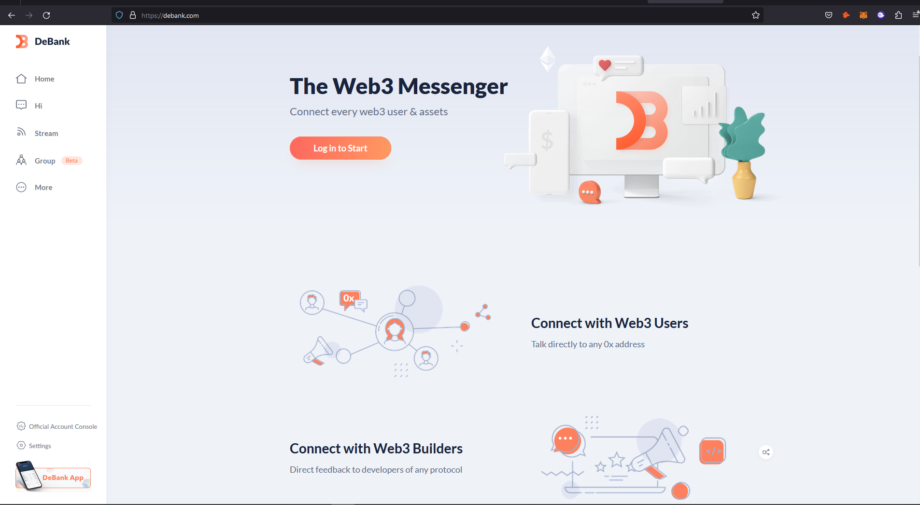
Home Page lacks clear information Hierarchy or succinct tag line as to what precisely the platform is meant for, at a glance

Slide 20
DeBank
UX AUDIT REPORT
TASK ORIENTATION
People go to web sites to achieve particular goals, not to look around and admire the design. This means web pages needs to support customer tasks. A site is task oriented when it supports users in the effective and efficient completion of their tasks.

Slide 21
Issue (LOW)
Recommendations
The current user flows involve unnecessary screens, contributing to a higher-than-necessary screen count for each task.
Progressive Disclosure:Information is presented across multiple screens without considering progressive disclosure, potentially overwhelming users.
Task sequences may not be structured to prioritize the most critical user actions, leading to a potential disconnect from users' primary objectives.
The current platform lacks the ease of exploration and accessibility necessary for users to try out different options before committing themselves
Conduct a comprehensive analysis of existing task flows to identify redundant steps or screens. Streamline the process by eliminating unnecessary intermediary screens, ensuring that each step contributes directly to task completion. Prioritize a user-centric approach that minimizes the cognitive load and effort required to accomplish tasks.
Implement a progressive disclosure strategy that unveils information progressively, only presenting details when users actively seek them or when it is contextually relevant. This approach avoids cluttering screens with unnecessary information and simplifies the user journey.
Provide interactive demos or simulations that allow users to experiment with various options and scenarios before making any commitments.

Slide 22
Issue (LOW)
Recommendations
Task sequences may not be structured to prioritize the most critical user actions, leading to a potential disconnect from users' primary objectives.
The current platform requires users to remember information from place to place, leading to a fragmented user experience and potential user errors. Users are unable to seamlessly transition between different sections or tasks without recalling previous information, which can be frustrating and hinder their overall productivity.
Enhanced Onboarding Process:The onboarding experience is not adequately guiding first-time visitors through the platform's key features and functionalities.
Design task-driven interfaces that prioritize and guide users through the most common and essential tasks they perform within the platform. Ensure that the interface layout and navigation align with users' priorities, minimizing the effort required to access key functionalities and complete primary tasks.
Implement contextual navigation elements that dynamically adapt based on users' current activities. Contextual menus, tooltips, or inline links can guide users to relevant screens and actions, eliminating unnecessary detours and enhancing the coherence of the user journey.
Ensure that user sessions remain active for a reasonable duration, allowing users to revisit the platform and continue their work without needing to start from scratch.

Slide 23
DeBank
UX AUDIT REPORT
NAVIGATION AND INFORMATION ARCHITECTURE
System or mechanism that allows users to move through different sections, pages, or features of a digital product. It includes menus, links, buttons, search bars, and other interactive elements that help users find and navigate to desired content or perform specific actions. Effective navigation design ensures that users can easily understand and access different areas of the product, enhancing usability and user satisfaction.
Information architecture (IA) involves the organization and structure of information within a digital product to facilitate efficient and intuitive access. It focuses on grouping and categorizing content in a logical and meaningful manner, ensuring that information is well-organized, easily discoverable, and understandable to users.

Slide 24
Issue (MEDIUM)
Recommendations
Consistent Home Link: Users do not have a consistent and easily accessible link or button to return to the home page.
The platform currently fails to meet the criteria for effective navigation tabs. While navigation tabs are present, they do not align with the expected location at the top of the page, and their visual design does not resemble clickable versions of real-world tabs.
Content Relevance Assessment:The platform contains irrelevant or unnecessary information, leading to a cluttered user experience.
Introduce a persistent and clearly labeled "Home" link or button that is consistently visible across all pages. This ensures that users can return to the home page with a single click, regardless of their current location within the platform. Make the home link prominent, possibly in the navigation bar or as a standalone element.
Move the navigation tabs to the top of the page, aligning with the conventional placement that users commonly expect. This ensures consistency with established design patterns and facilitates a more intuitive user experience. Users will instinctively look to the top for navigation, and placing tabs there enhances visibility.

Slide 25
Issue (LOW)
Recommendations
Optimized Information Hierarchy:The current information hierarchy is convoluted, leading to unnecessary scrolling and clicking.
Condensed Navigation Paths: Navigation paths may be convoluted, requiring users to click through multiple pages to reach their desired destination.
Conduct a thorough content audit to identify and remove information that is irrelevant or adds little value to the user experience. Prioritize content that aligns with user needs and goals, eliminating elements that contribute to visual noise or confusion
Reevaluate and optimize the information hierarchy to ensure that key information is easily accessible without requiring extensive scrolling or clicking. Prioritize essential content on the homepage and primary navigation, reducing the need for users to delve deep into the site structure.
Streamline navigation paths by condensing related information and actions. Aim for a simplified menu structure that minimizes the number of clicks needed to access critical sections. Consider consolidating content and actions on fewer pages to reduce the overall interaction cost for users.

Slide 26
Issue (LOW)
Recommendations
Comprehensive Task Overview:The platform does not present users with a comprehensive overview of all the steps involved in a task.
Progress Feedback:Users lack real-time feedback on their current position within the task workflow.
Implement a visual representation of all steps in a task, providing users with an overview of the entire workflow. This could be presented in the form of a progress bar, step indicators, or a dedicated section displaying each step. A clear, at-a-glance view helps users understand the task's structure and requirements.
Introduce visual cues, such as highlighted or marked steps, to indicate the user's current position in the workflow. This feedback provides users with a sense of progress, context, and reassurance as they navigate through the steps. It enhances the user's understanding of where they are in the process.

Slide 27
Issue (MEDIUM)
Recommendations
Revise Navigation System for Broad and Shallow Structure:The navigation system is perceived as deep rather than broad and shallow.
Simplify Site Structure and Conceptual Model:The site structure lacks simplicity, with unnecessary levels.
Navigational feedback is insufficient, potentially causing disorientation.
Restructure the navigation menu to be broad and shallow, with fewer menu levels and more items visible on the main menu. Group related items logically, ensuring that users can access key sections directly from the main menu without the need for excessive clicks. This simplification facilitates easier navigation and faster access to content.
Simplify the site structure by eliminating unnecessary levels and streamlining the conceptual model. Conduct a thorough content audit to identify and remove redundant or less essential sections. Ensure that the site's structure aligns with user expectations, making it intuitive and straightforward to navigate.
Provide clear and consistent navigational feedback to users. Implement visual indicators, such as breadcrumbs or highlighted menu items, to show users where they are in the site hierarchy.

Slide 28
Issue (LOW)
Recommendations
Consistent Behavior of the Back Button:Clicking the back button does not consistently take the user back to the expected page.
Ensure consistent behavior of the back button by mapping it to the expected user flow. Analyze and optimize the page history and navigation stack to align with user expectations. Consistency in back button behavior contributes to a more predictable and user-friendly experience.

Slide 29
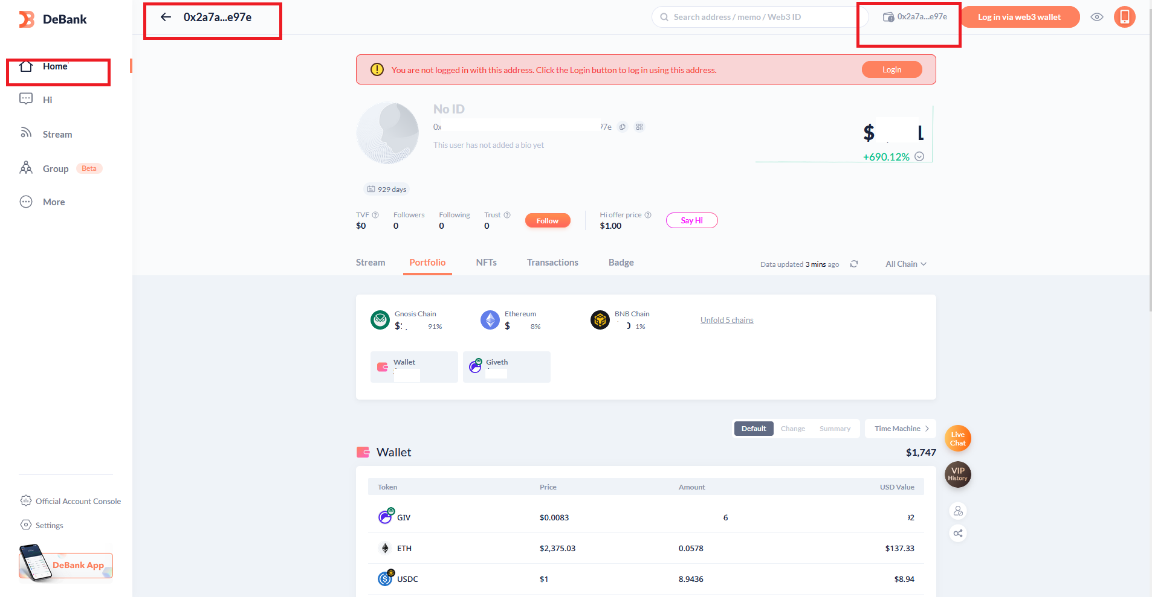
User account details is still shown even after disconnecting wallet. User can’t completely disconnect wallet details from showing on the platform.

Slide 30
The Back button and the home icon do not return users back to the Homepage (it redirects users by switching between the “Hi” and “user account” section instead

Slide 31
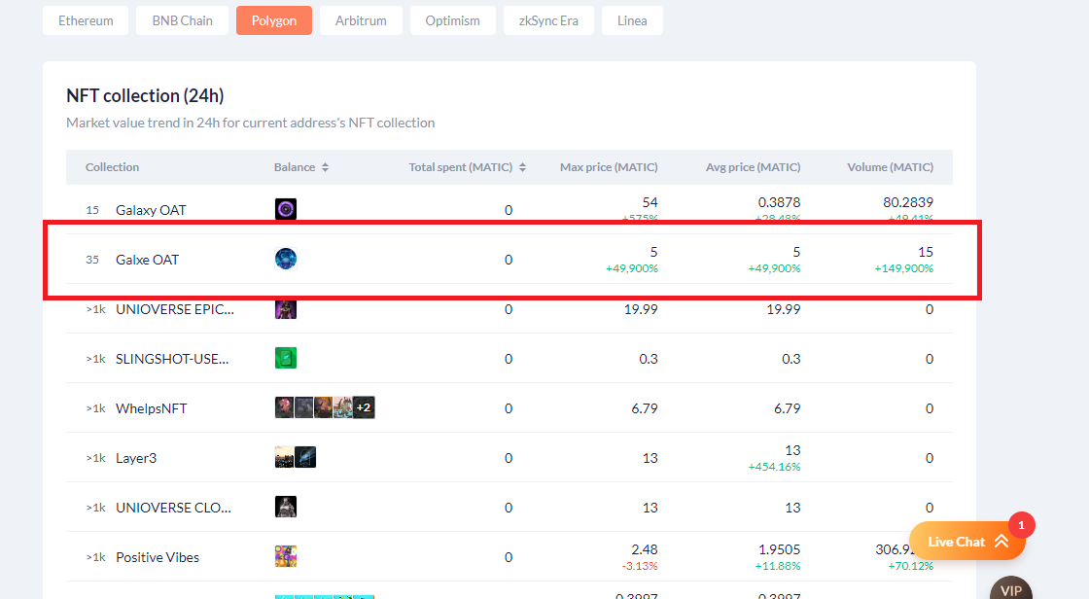
A new browser window opens when you click on each account details across board on the site
The number of screens required per task is too much. A new screen and window is opened per click for users. Information is scattered across multiple pages, on different browsers requiring users to navigate extensively.

Slide 32
DeBank
UX AUDIT REPORT
TRUST AND CREDIBILITY
A site has credibility when customers trust the content and the organisation behind it. This is critical in forming customers' opinions of the brand

Slide 33
Issue (LOW)
Recommendations
Strategic Placement of Non-Intrusive Ads:The platform may still require advertising for revenue, but it should be done in a user-friendly manner.
If advertising is a necessity, strategically place non-intrusive ads within the platform. Consider integrating ads in areas that do not interfere with critical content or user tasks. Maintain a balance between revenue generation and preserving a positive user experience. Opt for formats that are less disruptive, such as banners or sponsored content that coexists harmoniously with the platform's layout.

Slide 34
DeBank
UX AUDIT REPORT
WRITING AND CONTENT QUALITY
Effective writing and content quality play a crucial role in communicating ideas, establishing credibility, and delivering a positive user experience. By prioritizing these aspects, organizations can create compelling content that resonates with readers, promotes understanding, and achieves its intended objectives

Slide 35
Issue (LOW)
Recommendations
The platform currently falls short of providing pages that are quick to scan, characterized by ample headings and subheadings, along with short paragraphs. The content layout and formatting do not optimize the user's ability to scan and absorb information efficiently. This lack of content structure may lead to cognitive overload and hinder users in quickly finding relevant information.
Establish a structured hierarchy of headings and sub-headings to visually organize content. Use different font sizes, styles, or colors to distinguish between heading levels. This hierarchy aids users in scanning and navigating the page, allowing them to focus on the most relevant sections based on their information needs.

Slide 36
DeBank
UX AUDIT REPORT
PAGE LAYOUT AND VISUAL DESIGN
The checkpoints in this area ask if the dialogue is aesthetic and minimalist. Appropriate visual design means that the fonts, icons, colours and layout help the customer complete common tasks and that pages do not contain information that is irrelevant or rarely needed.

Slide 37
Issue (MEDIUM)
Recommendations
Visual Hierarchy for Next Steps: The visual hierarchy of the layout may not effectively emphasize the elements associated with the next steps, causing user uncertainty.
The current platform fails to provide a clear visual "starting point" on each page, resulting in a disorienting and confusing user experience. Users struggle to identify where to begin their interactions or find relevant information, leading to frustration and a lack of engagement
Establish a visual hierarchy that directs users' attention toward the elements indicating the next steps. Utilize size, color, and positioning to prioritize key information or actions. Enhance the contrast between essential elements and background content, making it intuitive for users to identify where to focus their attention for guidance on what to do next.
Designate a focal point on each page, such as a visually appealing image or an essential piece of information. This focal point draws users' attention and directs them to the critical content or action on the page.

Slide 38
Issue (MEDIUM)
Recommendations
Consistent Use of Clickable Affordances:Inconsistency in the application of clickable affordances may confuse users.
Grid-Based Alignment of Items:Horizontal and vertical alignment of items may vary, creating a disjointed visual experience.
Establish and consistently apply design patterns or affordances that indicate clickability across the platform. Whether it's buttons, links, or interactive elements, maintain a cohesive and recognizable style for clickable items. Consistency enhances predictability, helping users recognize interactive elements more easily.
Align items, text, and widgets to the established grid system. Maintain a consistent alignment both horizontally and vertically, ensuring a neat and organized layout. This grid-based approach contributes to a visually pleasing and structured design that enhances the overall user experience.

Slide 39
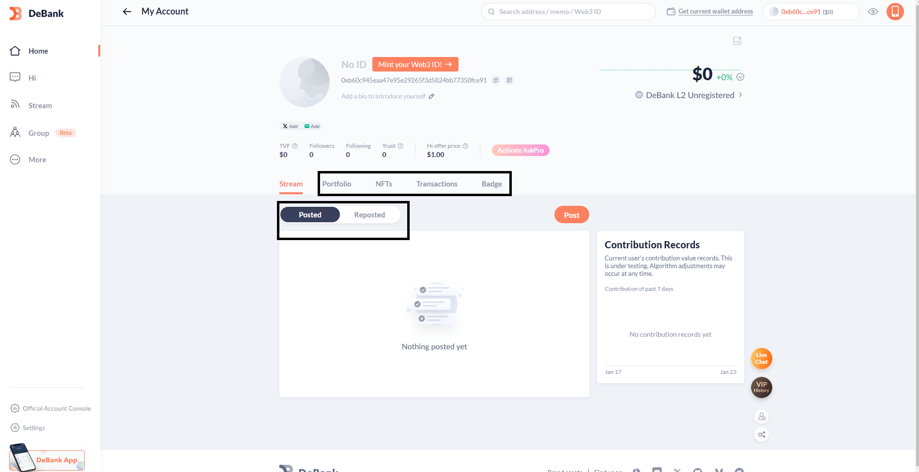
There is a visible change when the mouse points/hovers over some clickable elements (excluding cursor changes)

Slide 40
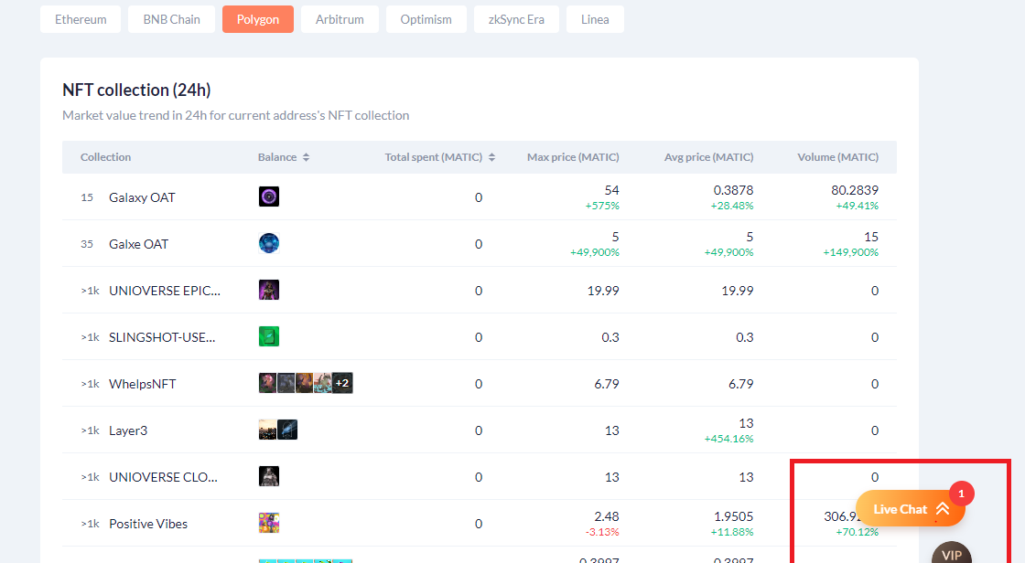
Some pages are not free of clutter and users can be distracted from completing a task

Slide 41
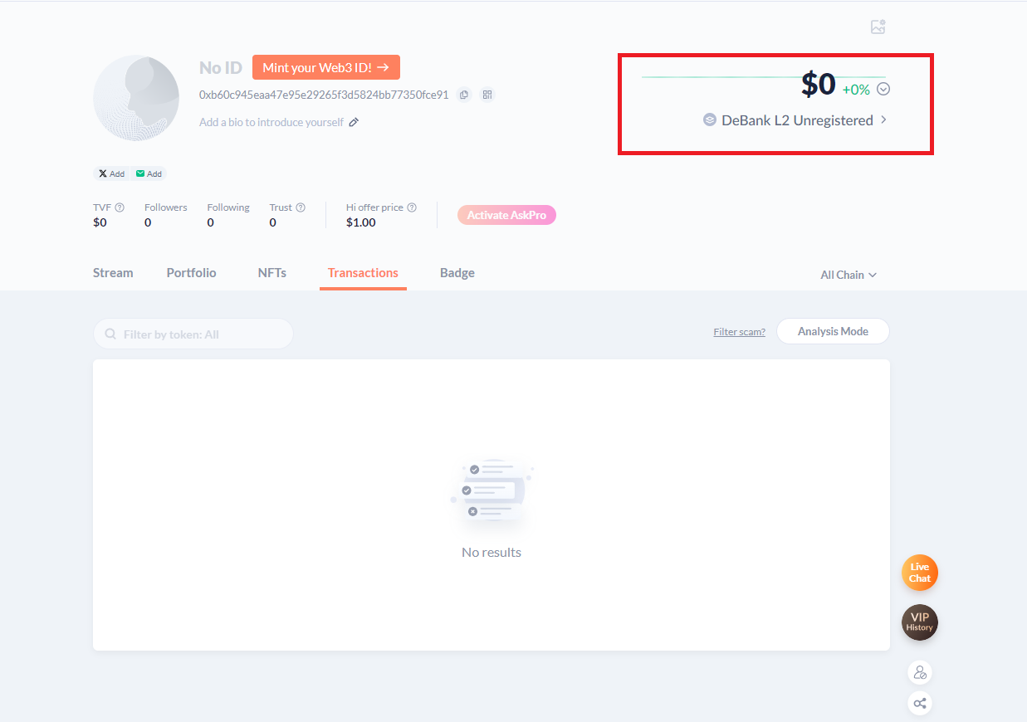
Inconsistency in design elements. The base green line runs across portfolio value in this case.

Slide 42
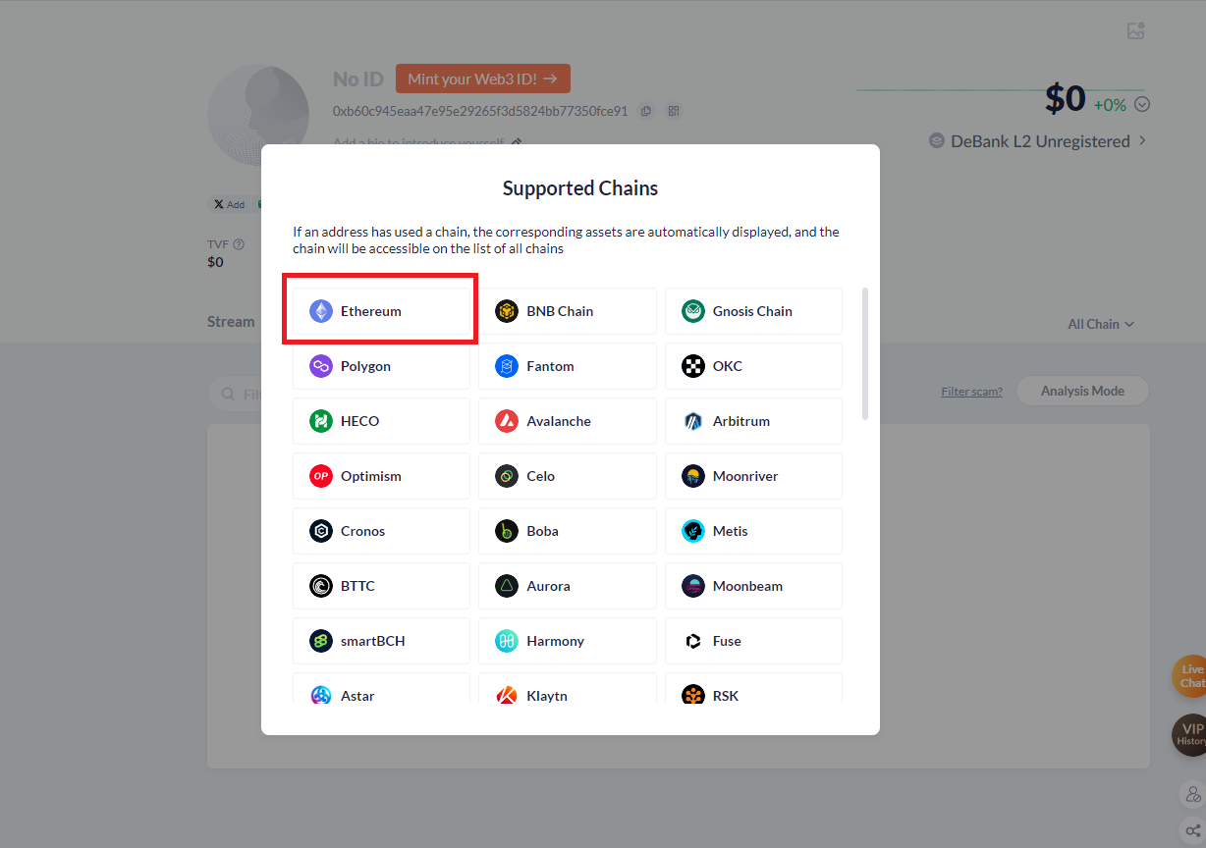
Some Items that aren't clickable do have characteristics that suggest that they are. This can be confusing to the user

Slide 43
DeBank
UX AUDIT REPORT
SEARCH USABILITY
Search is one of the dominant ways that many customers interact with web sites. A good search engine needs to acknowledge the 'human' side of searching, which means dealing with spelling errors and synonyms (such as 'laptop' for 'notebook'). Google has set the standard for how search should look and behave, and many of these guidelines are based on this best practice.

Slide 44
Issue (LOW)
Recommendations
Error Message with Suggestions: The platform does not present informative error messages or suggestions when no results are returned.
Query Enhancement Tips: Users are left without guidance on how to improve their query when it fails to yield results.
The current platform fails to include a more powerful search interface to help users refine their searches effectively. The absence of a robust search functionality, such as "revise search" or "refine search," limits users' ability to find specific and relevant results, leading to frustration and suboptimal user experience
The current platform fails to allow users to set up complex searches and save them for regular execution, resulting in a subpar user experience. The absence of this feature limits users' ability to stay updated with dynamic content and hinders their ability to perform advanced searches efficiently.
Implement error messages that not only inform users about the absence of results but also provide constructive suggestions for refining their query. Analyze the user's input to identify potential issues and offer specific recommendations or examples to guide users toward more successful search queries.
Introduce a section or pop-up that offers query enhancement tips when no results are found. This could include prompts on using synonyms, adjusting the search parameters, or providing additional context. The goal is to empower users with actionable insights to refine their search and achieve better results
Introduce a "revise search" or "refine search" feature prominently on the search results page. This feature should allow users to modify their search criteria easily and perform more granular searches.

Slide 45
Issue (LOW)
Recommendations
The current platform fails to make the scope of the search explicit on the search results page, and users lack the ability to restrict the scope, resulting in a deficient user experience. Users are left uncertain about the search context and may struggle to find relevant information due to the lack of explicit scoping options.
Implement a feature that allows users to save complex search queries for future use. Users should have the option to name and store their searches, making it convenient to execute them regularly.
Clearly display the search scope on the search results page. Include a descriptive label or heading indicating the parameters of the search, such as the categories or filters applied.

Slide 46
DeBank
UX AUDIT REPORT
ERRORS, HELP AND LEARNABILITY
These guidelines help assess if the site helps prevent customers from making errors. A site is error-tolerant if, despite evident errors in input, the intended result may be achieved with either no or minimal corrective action by the customer.
For novices and experts alike there should be readily available ways for them to become comfortable with using your product. Easy access to FAQs, onboarding etc.

Slide 47
Issue (MEDIUM)
Recommendations
The current platform fails to show users how to do common tasks, even where appropriate, resulting in a deficient user experience. Users lack access to demonstrations or tutorials that could guide them on utilizing the platform's functionality effectively, leading to frustration and reduced user engagement.
The current platform fails to provide feedback that helps the user learn how to use the site, resulting in a subpar user experience. Users are left without the necessary guidance and context to explore and utilize the platform's features effectively, leading to potential confusion and reduced engagement
Develop an onboarding process that introduces users to the platform's key features and functionalities. Use interactive elements and informative screens to educate users on how to use the platform effectively. Use tooltips and pop-ups strategically to provide contextual guidance for specific actions. These informational cues should be unobtrusive but easily accessible to users who need additional help.
Incorporate contextual "Did You Know?" tips that appear at relevant points throughout the user journey. These tips should offer insights, shortcuts, or helpful hints to assist users in understanding and utilizing specific features. Progressive Disclosure: Employ progressive disclosure techniques to gradually reveal additional features and information as users interact with the platform. This approach prevents overwhelming users with too much information at once.

Slide 48
DeBank
UX AUDIT REPORT
TRANSPARENCY OF DATA PROVENANCE
Does the application clearly indicate which data comes from the blockchain and which does not?
Are the addresses of the contracts clearly stated?
Are all blockchain data linked to independent blockchain explorers?
Is it clear which data comes from oracles?

Slide 49
Issue (LOW)
Recommendations
Blockchain Data Indicators: The platform does not clearly indicate which data originates from the blockchain, leaving users uncertain about the source of information.
Introduce visual indicators, such as icons or labels, to clearly differentiate blockchain-derived data from other sources. Ensure that these indicators are consistently applied across relevant sections of the platform. This visual cue enhances transparency, helping users discern the authenticity and reliability of the displayed data.

Slide 50
DeBank
UX AUDIT REPORT
TRANSPARENCY OF SMART CONTRACT EVENTS
Are all events, even those for developer purposes, clarified and made accessible to the end user?
Are interrupting messages shown only for information relevant to the current user?
Can users subscribe to, unsubscribe from, or temporarily mute certain events?

Slide 51
Issue (LOW)
Recommendations
Event Visibility and Accessibility:Events, particularly those designated for developer purposes, are not adequately visible or accessible to end users
Ensure that all events, including those relevant to developers, are prominently displayed in a dedicated section accessible from the platform's main interface. Create a clear pathway for end users to discover and engage with various events.

Slide 52
DeBank
UX AUDIT REPORT
TRANSPARENCY AND ACCESSIBILITY OF USER’S INTERACTION HISTORY
Does the application provide a history of all transactions from a given address?
Is it clear where the history is stored (local or server)?
Are tools provided to navigate, search, export, and delete the history cache?

Slide 53
Issue (LOW)
Recommendations
The platform does not provide clear indications of where the user's history is stored, whether it is stored locally on the user's device or on the server. This lack of clarity can lead to user confusion and concerns regarding data privacy, accessibility, and potential data loss.
DeBanks does not provide users with the necessary tools to navigate, search, export, or delete the history cache. This lack of functionality restricts users from efficiently managing and leveraging their transaction history, impacting usability and user control.
Clearly communicate to users whether their history is stored locally on their device or on the server. This can be achieved by providing explanatory text or tooltips that detail the storage location and the implications associated with it, such as data synchronization or potential limitations.
Introduce user-friendly tools to navigate, search, export, and delete the history cache.
These features will enable users to efficiently access and manipulate their transaction data, enhancing usability and user control.

Slide 54
DeBank
UX AUDIT REPORT
TRANSPARENCY OF CODE
Is it clear which blockchain is being used?
Are the addresses of the Smart Contracts used in read/write operations clarified?
Is it clear which code is open source and where to find it?
Is it clear where code is being run (local vs remote server)?
Is the web3 provider / Blockchain node clarified?

Slide 55
Issue (LOW)
Recommendations
Open-Source Code Badges: The platform lacks visual indicators or badges that clearly highlight open-source components, making it difficult for users to identify the available open-source code.
Code Execution Indication: The platform does not clearly indicate whether the code is being run locally on the user's device or on a remote server.
The platform does not make it clear which data originates from oracles or has been influenced by oracles.
Introduce recognizable badges or icons next to sections of the platform that feature open-source code. These badges should be consistent and prominently displayed, ensuring that users can quickly identify and distinguish open-source components. This visual cue serves as an immediate indicator of areas where users can access and contribute to the code.
Clearly indicate when data is sourced from or influenced by oracles. This transparency will empower users to differentiate between data from different sources.

Slide 56
DeBank
UX AUDIT REPORT
PERMANENT NEWBIE MODE
Is educational information woven into normal interaction?
Are there 2 or more levels of educational content: Blockchain basics and Dapp specific lingo?
Is the amount of new things and concepts that the user needs to learn minimized and increased progressively?

Slide 57
Issue (MEDIUM)
Recommendations
The platform does not provide two or more levels of educational content, covering both blockchain basics and Dapp-specific terminology.
Develop two or more levels of educational content, including blockchain basics and Dapp-specific lingo, to cater to users with varying levels of familiarity.
Contextual Tooltips: Educational information is not presented contextually during user interactions, leading to a lack of immediate guidance.
Integrated Educational Content: Integrate educational information seamlessly into normal interactions, providing users with relevant explanations, tooltips, or guided tutorials that enhance their understanding of the platform's features and processes.
Multi-Level Educational Resources: Develop two or more levels of educational content, including blockchain basics and Dapp-specific lingo, to cater to users with varying levels of familiarity. These resources should cover essential concepts, terminologies, and best practices to empower users to make informed decisions.

Slide 58
Issue (MEDIUM)
Recommendations
Inline Tutorials:There is a lack of interactive inline tutorials or guided walkthroughs that educate users within the natural flow of their interactions.
Implement contextual tooltips or pop-ups that appear alongside relevant features or actions, offering concise educational snippets. These tooltips should provide brief explanations, tips, or links to more in-depth resources, enhancing the user's understanding as they navigate the platform.
Introduce inline tutorials that guide users through specific tasks or features as they engage with the platform. These tutorials can be embedded within relevant sections, providing step-by-step guidance and explanations to enhance user comprehension.

Slide 59
DeBank
UX AUDIT REPORT
GAS PRICE AND TRANSACTION REVERSAL
Is what Gas and Gas price clarified?
Are gas prices ranges suggested and time approximations for the upper and lower bounds clarified?
Are transaction reversals allowed?

Slide 60
Issue (MEDIUM)
Recommendations
Gas Price Ranges and Time Approximations: The platform does not suggest gas price ranges or provide time approximations for the upper and lower bounds. This absence of information makes it challenging for users to estimate transaction costs and plan their interactions accordingly. Clear suggestions and time approximations would help users make informed decisions based on factors like network congestion and gas fees.
The platform does not provide a clear and concise explanation of what gas is and how it functions within the blockchain context. Users may encounter terms such as "gas" and "gas price" without understanding their meaning and significance, leading to confusion and uncertainty
Gas Price Ranges and Time Estimates: Suggest gas price ranges and provide time approximations for the upper and lower bounds. This information will assist users in estimating transaction costs and better planning their interactions based on network conditions and gas fees.
Provide an accessible and user-friendly explanation of what gas is and how it relates to transactions on the blockchain. Use simple and concise language to describe the purpose and function of gas, including its role in determining transaction fees and computational resources. Consider using visual aids or interactive elements to enhance understanding.

Slide 61
DeBank
UX AUDIT REPORT
USABILITY SCORE

Slide 62
144 /190
GOOD
Users should be able to use this site or system with relative ease and should be able to complete the vast majority of important tasks.
USABILITY SCORE
Ultimately, the usability score is a quantitative or qualitative representation of how usable and effective a product is in meeting user needs and goals. It helps evaluate the success of UX design and identify areas for improvement to enhance the overall user experience.

Slide 63
DeBank
UX AUDIT REPORT
NEXT STEPS

Slide 64
NEXT STEPS
Suggestions to improve the DeBank experience
#1
Incorporate Newbies in Product Roadmap -
Switch from focusing on product development for just veteran users of the blockchain and involve newbie users in developing a user-centric product.
#2
Implement Findings -
follow up the Implementation of the Research Findings on live platform.

Slide 65
DeBank
UX AUDIT REPORT
RESOURCES

Slide 66
SOURCES
Explore attached Unabridged UX audit detailed findings on DeBank
Expert Review Based On web Usability Guidelines Spreadsheet report
Expert review based on Web3 UX Principles by Beltran Spreadsheet report
Expert review collation and usability score report on Airtable spreadsheet Report

Slide 67



www.generalmagic.io

